Slide 1
Sydney Python Meetup Building an End to End Secure, Scalable IoT Serverless Solution
Dave Glover,
Microsoft Australia
Cloud Advocate
Follow me @dglover
https://github.com/gloveboxes/Integrate-IoT-Edge-Classifier-with-Python-Azure-Functions-and-Azure-SignalR

Slide 2
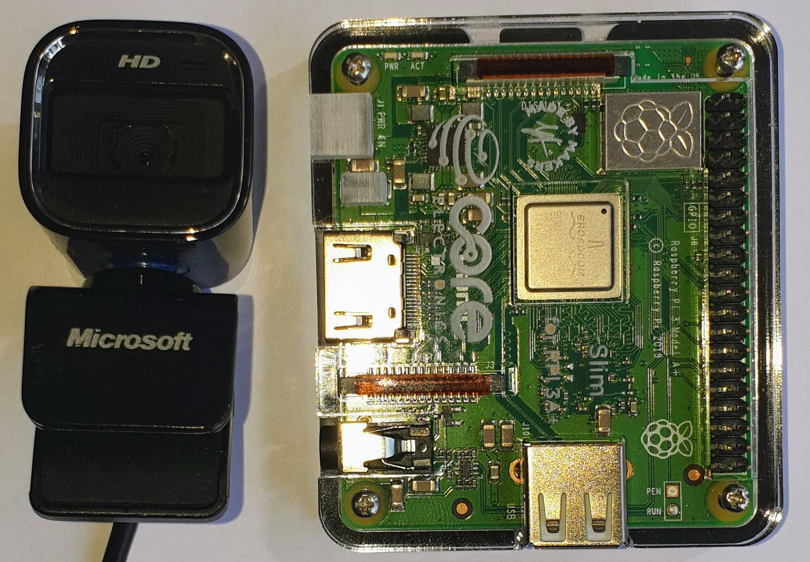

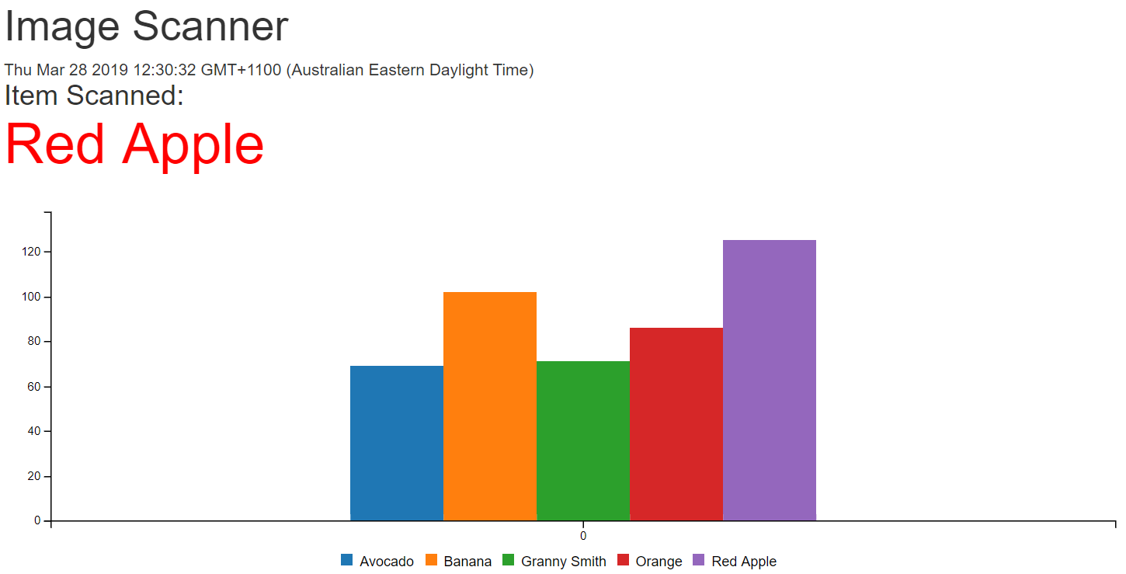
What we will cover
Python Image Recognition
(Azure IoT Edge)
Serverless & Azure Functions
Serverless Websites
(Azure Storage Static Websites)

Slide 3



Slide 4
Python & Custom Vision AI and Azure IoT Edge

Slide 5
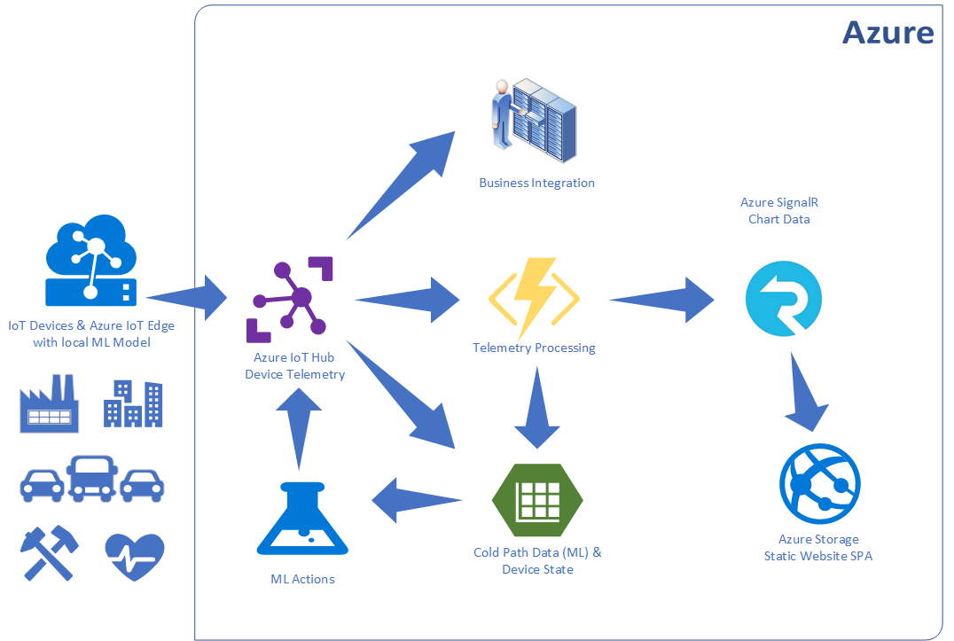
Integration IoT and Business

Slide 6
Python Image Recognition
Azure Custom Vision AI
Exported Python Container
https://www.customvision.ai/
Free Tier
Azure IoT Edge
Manages Deployment, Health, Updates
Container Based
Open Source
Free Tier

Slide 8
Serverless with Azure Functions

Slide 9
What is Serverless?
No infrastructure headaches
Scales on demand
Very cheap to run

Slide 10

Functions as a Service (FaaS)
Functions as a Service
Single Responsibility, Short Lived, Stateless, Event Driven & Scalable
Azure Functions (Implementation of FaaS)
Great Local Developer Experience
Hosting Flexible
Consumption Plan, App Service Plan, Premium, and Container
Consumption plan
Free grant of 1 million requests and 400,000 GBs per month
Open Source https://github.com/Azure/Azure-Functions

Slide 11
Notes:
Using Visual Studio Code to build Python Functions
Debugging Experience
Deploying to Azure

Slide 12
Serverless Web Pages & Azure SignalR

Slide 13


SignalR in Action
Azure IoT Hub
Azure Function
Telemetry Processor
Azure SignalR Service
Browser
Desktop
Mobile
Game
Event Hub Trigger
SignalR Output Binding
WebSocket, Server Sent Events,
and Long Polling

Slide 14
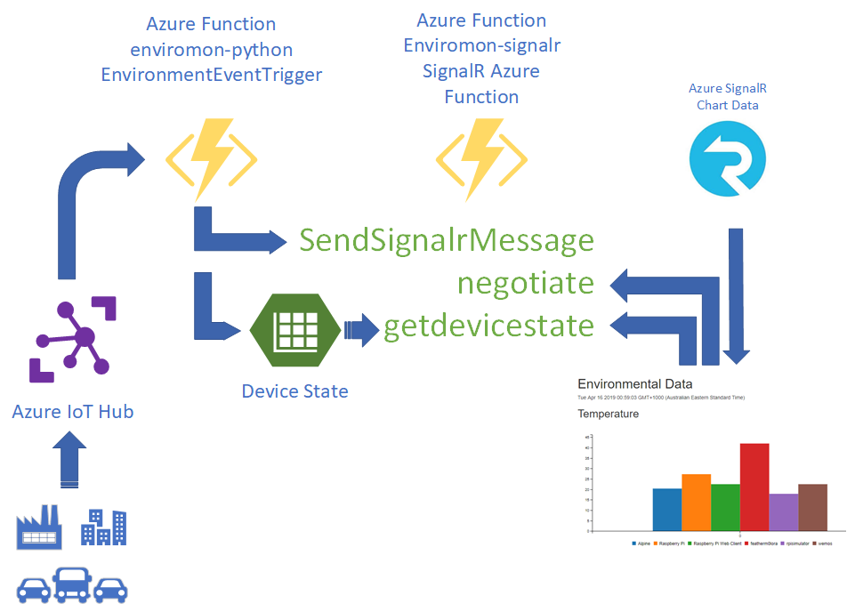
SignalR in Actions

Slide 15
Notes:
SignalR Trigger
Azure Storage Static Websites and Single Page Apps

Slide 16
Session Summary

Slide 17
Resources
Create your first Python function in Azure
Azure Custom Vision AI
Azure SignalR Service Documentation
Static website hosting in Azure Storage
Demoed Solution on GitHub (gloveboxes)
Azure Functions Python Worker

